Slide 1
‘Cuse-Miners
Karumudi, Bharath
Redden, Donald
Holley, Buffie
Reeves, Gretchen

Slide 2
The Data Set
3.4 million Instacart grocery transactions
The data is separated into six csv files highlighting different attributes of the transactions. The orders are separated into two categories; previous orders and training orders.
“The Instacart Online Grocery Shopping Dataset 2017”, Accessed from https://www.instacart.com/datasets/grocery-shopping-2017 on May 1, 2019.

Slide 3
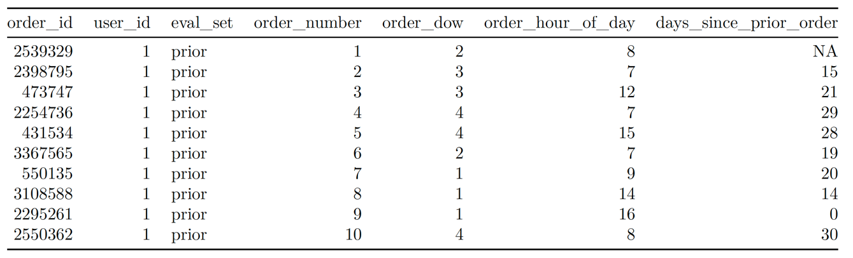
Orders
Notes:
As you can see the orders data set, includes the unique order_id, a user_id, which set it belongs to (prior, trian), the order number of the particular user, the day of the week the order was placed, the our of day the order was placed, and the number of days since the user’s last order with a maximum value of 30 days. The user’s first order to Instacard will have a days since prior order of NA.

Slide 4
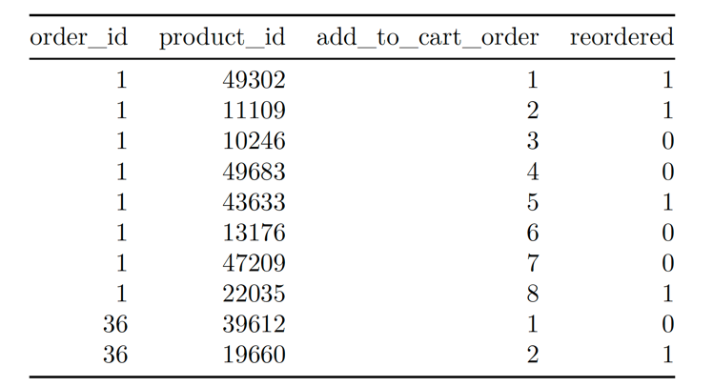
Order Products
Notes:
This piece of the data indicates the order the products are added to the card for each unique order_id. It also has a binary value as to whether or not the product is something being reordered by the user.

Slide 5
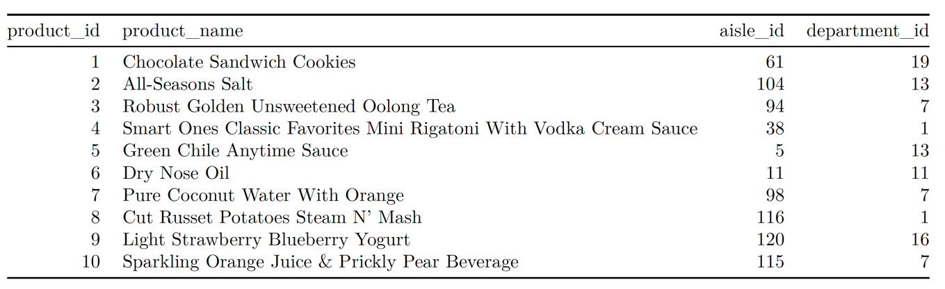
Products
Notes:
The products data includes the product id for each item, its name, and the aisle and department each product is in.

Slide 6
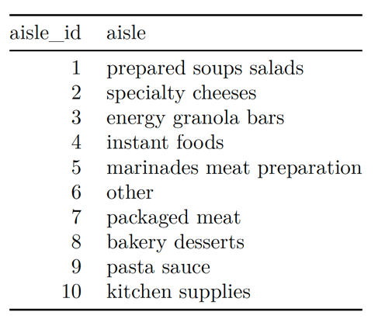
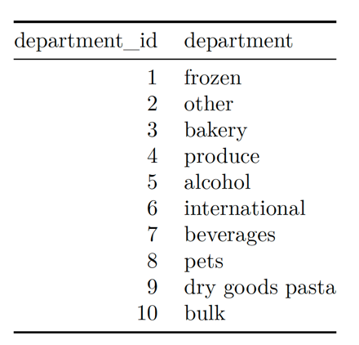
Aisle and Product Information
Notes:
The department and aisle ids are attached to the appropriate names.

Slide 7
Initial Observations

Slide 8
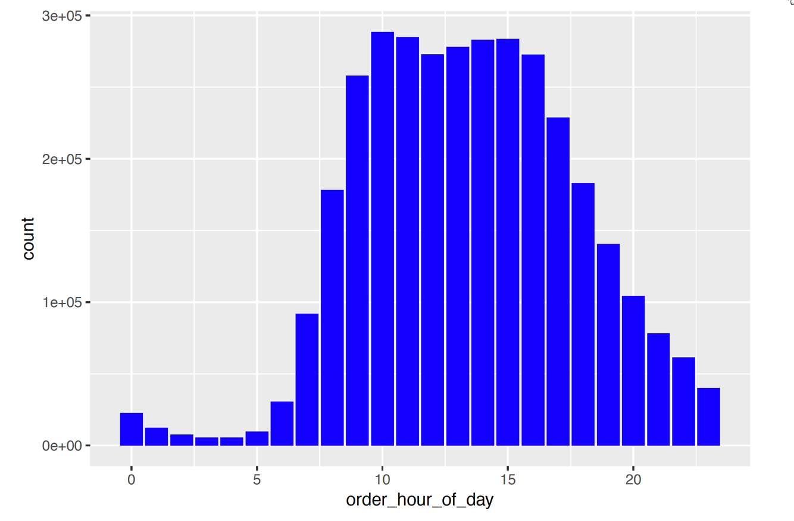
Notes:
As we can see here the majority of orders are placed between 08:00 and 18:00 or 8am and 6pm.

Slide 9
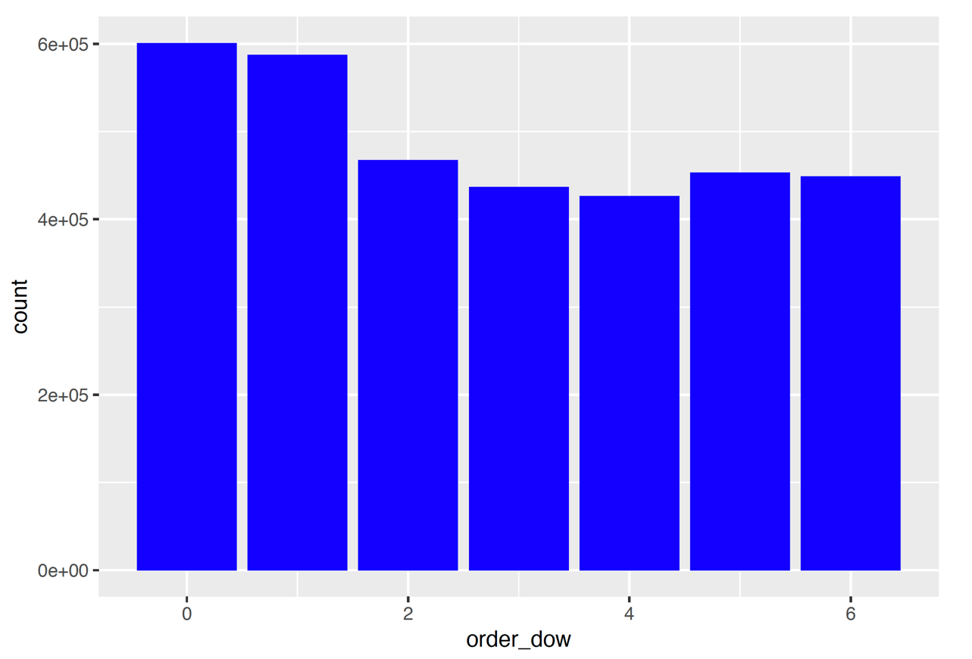
Saturday
Sunday
Monday
Tuesday
Thursday
Friday
Wednesday
Notes:
As you can see here there is definitely a heavier order volume on the weekend (Saturday & Sunday), but each of the remaining days of the week are pretty consistent as well. There is not a “slow” day.

Slide 10
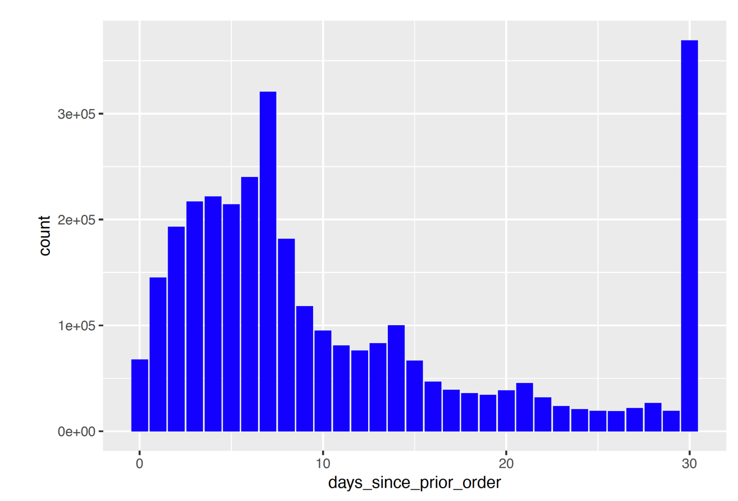
Notes:
As you can see here the two most regular reorder time frames are 7 days and 30 days. Meaning that a large number of customers tend to order once a week. There is also a large number of users that reorder monthly or more than monthly, remember the largest value for days since order is 30.

Slide 11
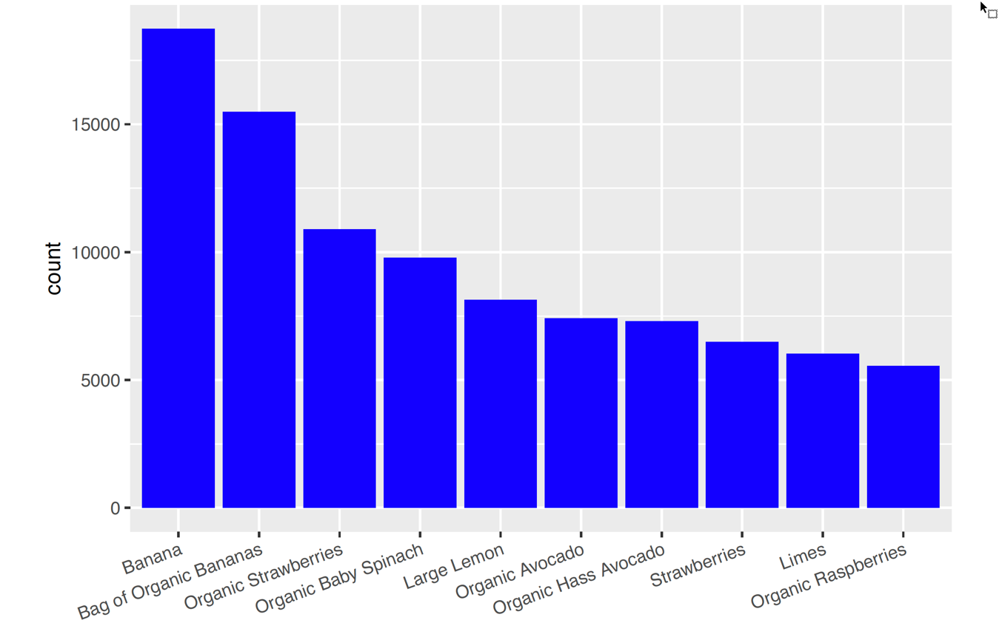
Top 10 Products
Notes:
It is clear that the most ordered product is Bananas, followed closely by Organic Bananas

Slide 12
Market Basket Analysis

Slide 13
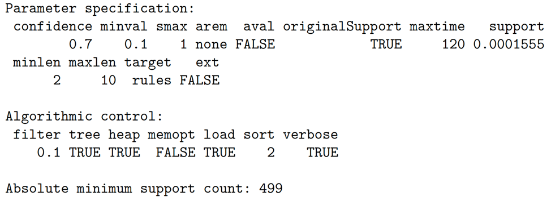
Apriori
apriori (transactions, parameter = list (supp=0.0001555 , conf=0.7 , minlen=2 , maxtime=120 ))

Slide 14
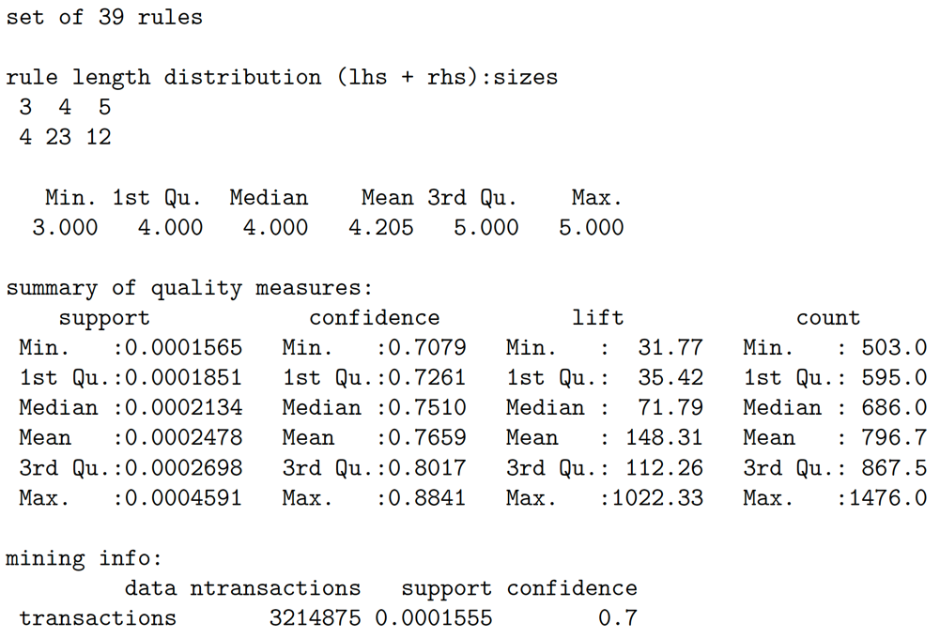

Slide 15
Association Rule # 1
lhs
{Lime Sparkling Water,
Peach Pear Flavored Sparkling Water,
Pure Sparkling Water,
Sparkling Lemon Water}
rhs
=> {Sparkling Water Grapefruit}

Slide 16
Association Rule # 9
Lhs
{Total 2% All Natural Greek Strained Yogurt with Honey,
Total 2% Greek Strained Yogurt with Cherry 5.3 oz,
Total 2% Lowfat Greek Strained Yogurt With Blueberry,
Total 2% Lowfat Greek Strained Yogurt with Peach}
rhs
=> {Total 2% with Strawberry Lowfat Greek Strained Yogurt}

Slide 17
Association Rule # 13
Lhs
{Oh My Yog! Madagascar Vanilla Trilayer Yogurt,
Oh My Yog! Organic Wild Quebec Blueberry Cream Top Yogurt & Fruit}
rhs
=> {Oh My Yog! Pacific Coast Strawberry Trilayer Yogurt}

Slide 18
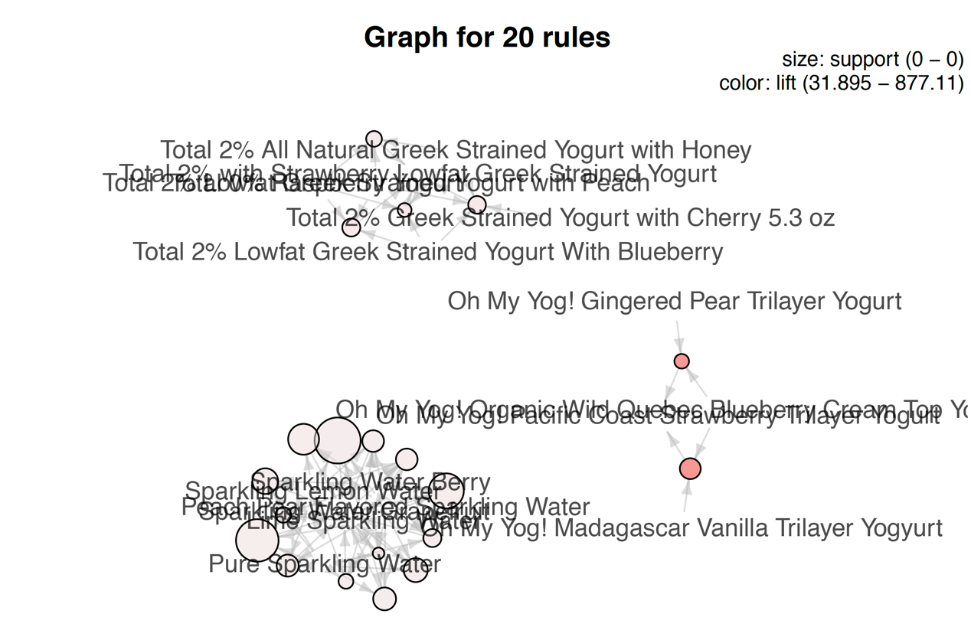

Slide 19
Customer Reordering Frequency

Slide 20
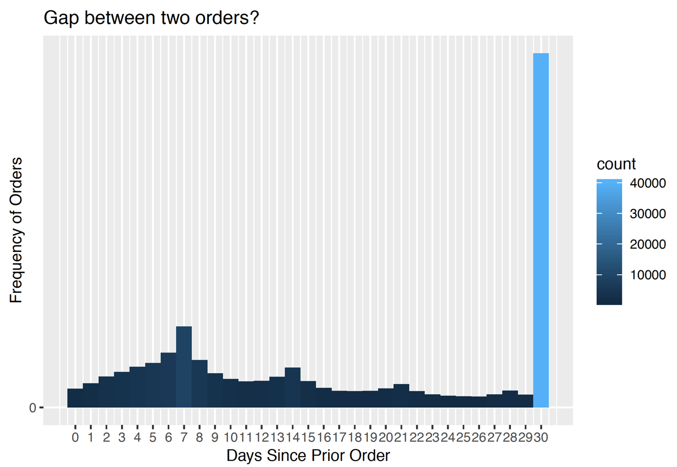
Notes:
Looking at above data we see that majority of customers order weekly, biweekly, monthly so we need to categorize them appropriately.

Slide 21
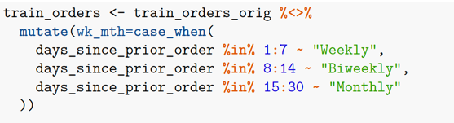
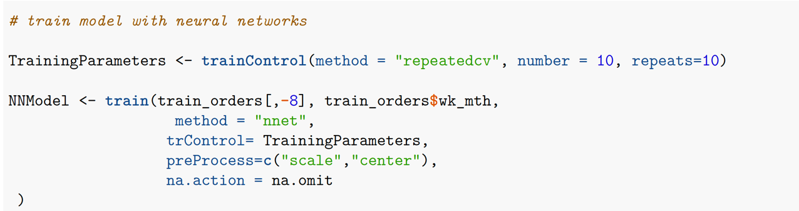
Training Neural Network Model
Notes:
Used full orders file and separated into train and test because preprocessing wouldn’t work with what we had and classified our customers into (weekly, biweekly, monthly) reorders (didn’t upload data because already in files)
Took 1.2 hours to run on Mac
Accuracy ~ 83%

Slide 22
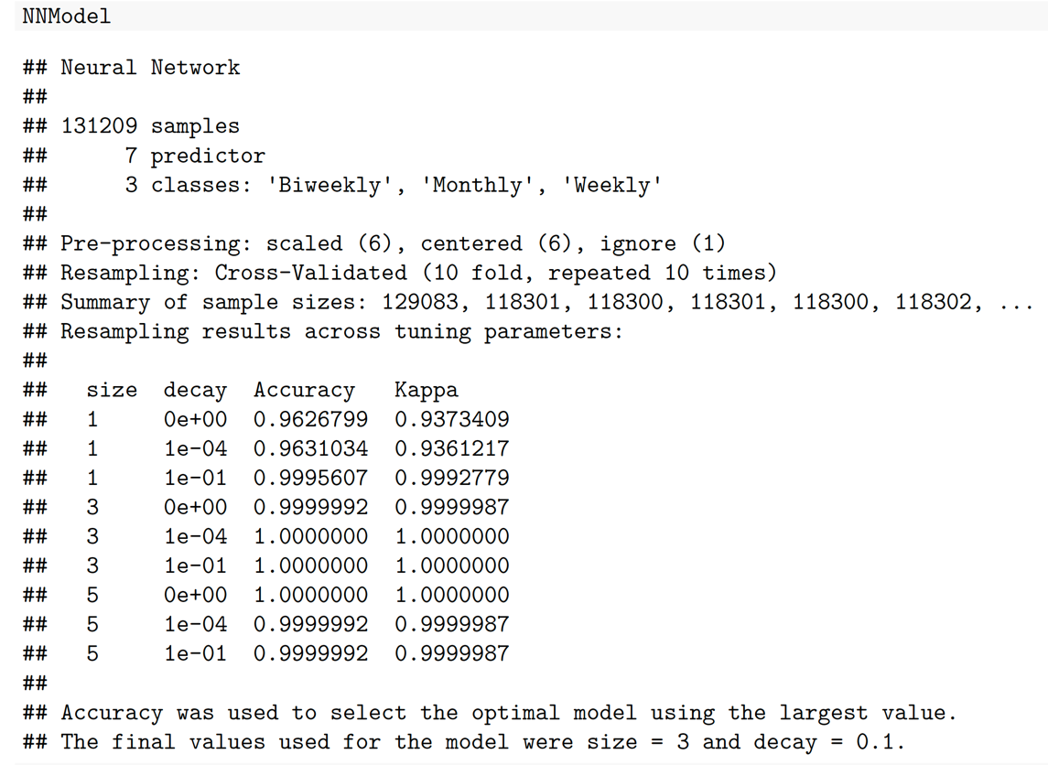

Slide 23
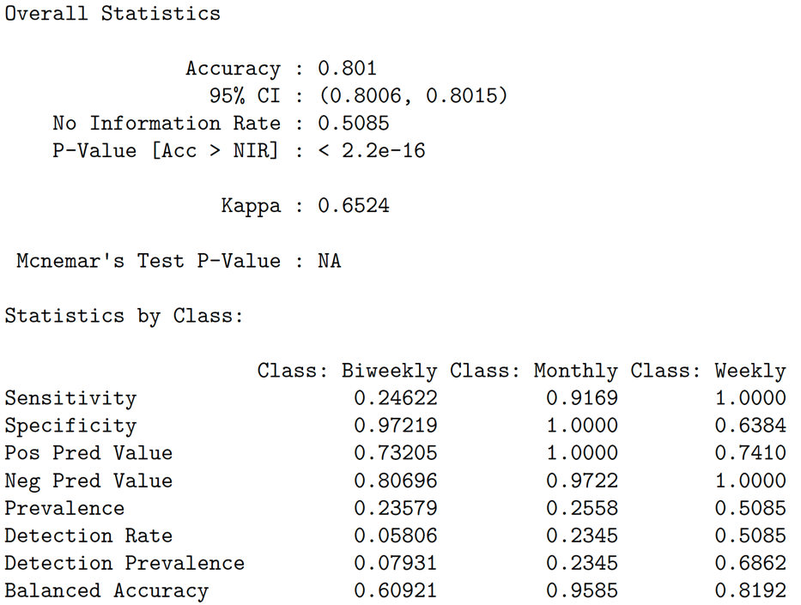
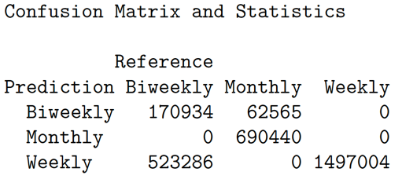
Model Accuracy

Slide 24
Add to Basket Analysis

Slide 25
Apriori Model Code
#apriorirules
rules <- apriori(trainTransactions, parameter = list(supp=0.05, conf=0.5,minlen=2, maxlen=5))

Slide 26
Top 10 Association Rules
[1] {Organic Lemon} => {Fresh Cauliflower} 0.06451613 1.0000000 10.333333 2
[2] {Organic Lemon} => {Organic Hass Avocado} 0.06451613 1.0000000 10.333333 2
[3] {Organic Cilantro} => {Organic Strawberries} 0.06451613 1.0000000 05.166667 2
[4] {Uncured Genoa Salami} => {Organic Italian Parsley Bunch} 0.06451613 1.0000000 15.500000 2
[5] {Organic Italian Parsley Bunch} => {Uncured Genoa Salami} 0.06451613 1.0000000 15.500000 2
[6] {Natural Spring Water} => {Organic Raspberries} 0.06451613 1.0000000 10.333333 2
[7] {Fresh Cauliflower,Organic Lemon} => {Organic Hass Avocado} 0.06451613 1.0000000 10.333333 2
[8] {Organic Hass Avocado,Organic Lemon} => {Fresh Cauliflower} 0.06451613 1.0000000 10.333333 2
[9] {Fresh Cauliflower,Organic Hass Avocado} => {Organic Lemon} 0.06451613 1.0000000 15.500000 2
[10] {Fresh Cauliflower} => {Organic Lemon} 0.06451613 0.6666667 10.333333 2

Slide 27
Apriori Model Accuracy
rule length distribution (lhs+ rhs):sizes
2 3
12 3
Min. 1st Qu. Median Mean 3rd Qu. Max.
2.0 2.0 2.0 2.2 2.0 3.0
summary of quality measures:
support confidence lift count
Min. :0.06452 Min. :0.5000 Min. : 2.583 Min. :2
1st Qu.:0.06452 1st Qu.:0.6667 1st Qu.: 8.611 1st Qu.:2
Median :0.06452 Median :1.0000 Median :10.333 Median :2
Mean :0.06452 Mean :0.8556 Mean :10.046 Mean :2
3rd Qu.:0.06452 3rd Qu.:1.0000 3rd Qu.:10.333 3rd Qu.:2
Max. :0.06452 Max. :1.0000 Max. :15.500 Max. :2

Slide 28
